Slide 1
KPIs
KPIs

Slide 2
KPIs
Note: This workshop uses directly entered data
Date | Turnover | Objective
01/01/2025 | 5000 | 10000
01/02/2025 | 7000 | 10000
03/01/2025 | 9500 | 10000
04/01/2025 | 11000 | 10000

Slide 3
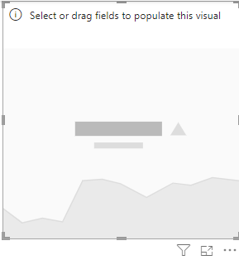
KPIs
KPI visual in the scene

Slide 4
KPIs
Import data
Load the Sales table into Power BI.
Make sure that the Date column is recognized as a date type field.
Add a KPI visual
In Power BI Desktop, click KPI in the visuals pane.
Drag Turnover into the Value field .
Drag Target into the Target field .
Drag Date into the Trend Axis field to view the trend.
Value → Main indicator ( example : figure business current ).
Value target → Objective to be achieved .
Axis → Indicates the trend over time.
Colors → Green if the objective East reached , Yellow if the result is neutral, red otherwise .

Slide 5
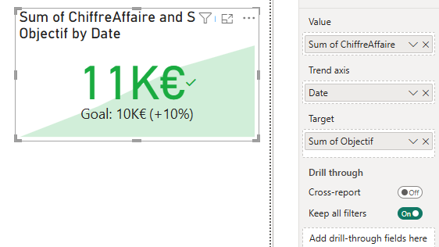
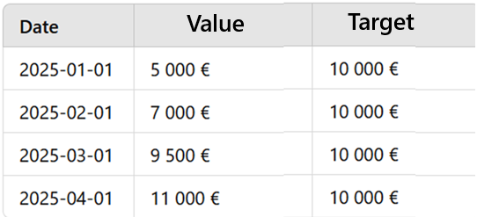
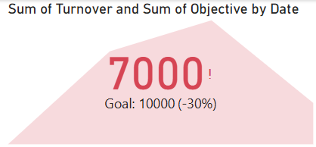
KPIs
Now we need to add the target. To do this, we need to create a metric that represents our goal.
Total Sum of the Figure Business = €32,500
Total amount of the Objective = €40,000
But Power BI takes uniquely in charge of the last one value ( €11,000 ) against €10,000

Slide 6
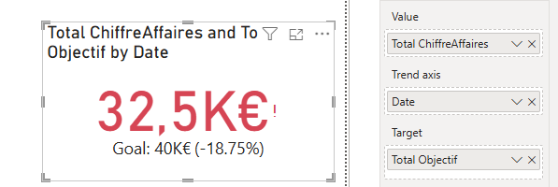
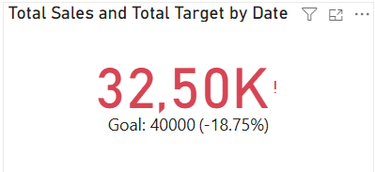
KPIs
It is also possible to take into consideration the sum, in this case it is necessary to create the aggregations
Total Sales = CALCULATE ( SUM ( Sales[Turnover]), ALL ( Sales ))
Total Target = CALCULATE ( SUM ( Sales[Objective]), ALL ( Sales ))

Slide 7
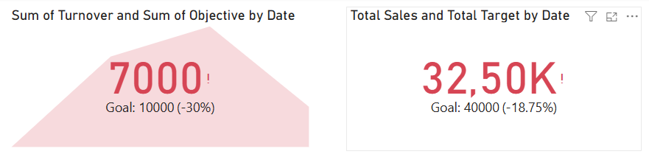
KPIs
Then the result is, first KPI indicates related indicator according to the last recorded data, meanwhile the second KPI is taking the sum of both recorded values and objectives

Slide 8
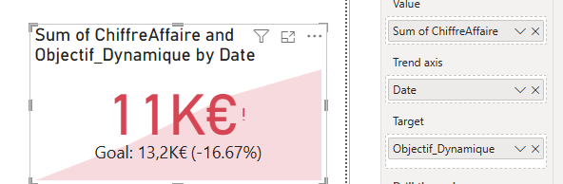
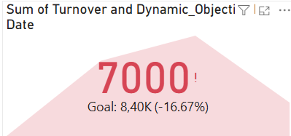
KPIs
It is also possible to calculate a dynamic objective
Dynamic_Objective = AVERAGE ( Sales[ Turnover ] ) * 1.2

Slide 9
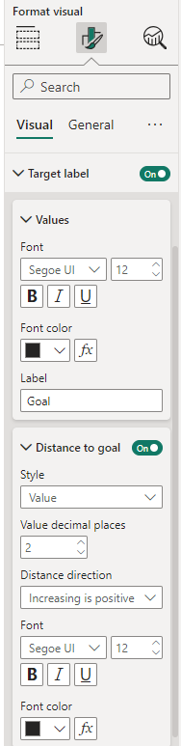
KPIs
Change the label value to be something other than a percentage

Slide 10
The personalized KPI

Slide 11
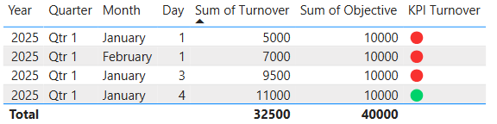
KPIs
Add a calculated column that returns a particular shape based on whether the goal was met or not
KPI Turnover = IF ( Sales[Turnover] > Sales[Target] , UNICHAR ( 128994 ), UNICHAR ( 128308 ))
The above measure compares the amount of Turnover to a target

Slide 12
Thank you
Thank you

